Slide 1

AN6100 Class A Group 7 Tracing Application
Xiong Yike
Zeng Linghao
Shao Xiaodan

Slide 2

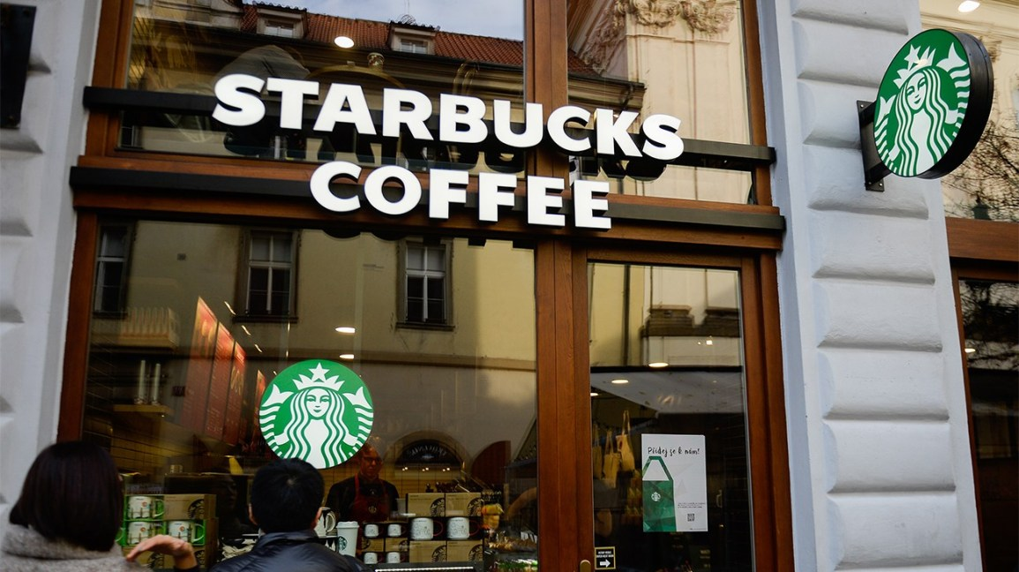

When you want to buy a cup of coffee
When you family want to watch a movie
Which gate you choose to enter?
How long would you stay?
https://images.app.goo.gl/cHKNvWsSqQbLT7zH9
https://images.app.goo.gl/bfDdQ2Pqwqi8FSnQ6

Slide 3
Agenda
Overview
Business Analytics
Live demo
Implications & Recommendations

Slide 4
01
02
Purposes
01
Objectives
Application
Overview
03
Justification

Slide 5
Objectives & Purposes
Mall Management
30%
30%
Help fight against COVID-19
Boost the sales opportunities
20%
20%
Reduce the time and hiring cost
Arrange the layout of the mall
Notes:
Help fight against COVID-19 by recoding the movement of people
Boost the sales opportunities of malls by data analysis
Reduce the time cost and hiring cost of information collection
Arrange the layout of the shopping mall reasonably

Slide 6
Justification
Our speciality：
Readability
Maintenanbility
fuzzy matching：Contact number
NRIC
Use C function in command R
Our budget：
Platfrom connection fee
Contingency Reserves

Slide 7
02
Live
Demo

Slide 8
03
02
Estimation
01
Data
Analysis
Business
Analytics
03
Evaluation

Slide 9
Data Analysis
Visualization
conclusion
Notes:
Help fight against COVID-19 by recoding the movement of people
Boost the sales opportunities of malls by data analysis
Reduce the time cost and hiring cost of information collection
Arrange the layout of the shopping mall reasonably

Slide 10
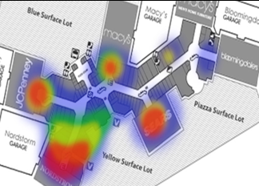
Estimation
traffic
Notes:
Help fight against COVID-19 by recoding the movement of people
Boost the sales opportunities of malls by data analysis
Reduce the time cost and hiring cost of information collection
Arrange the layout of the shopping mall reasonably

Slide 11

Evaluation
Consumption data are from similar industry.
Help management focus on the main force whose age is above 50 and is between 31-40.
Operation
Records
UI
Strategies
Customers
Safe-entry!
Customer results
Management
Notes:
Help fight against COVID-19 by recoding the movement of people
Boost the sales opportunities of malls by data analysis
Reduce the time cost and hiring cost of information collection
Arrange the layout of the shopping mall reasonably

Slide 12
Evaluation
How much revenue will boost
NPV
IRR
Notes:
Help fight against COVID-19 by recoding the movement of people
Boost the sales opportunities of malls by data analysis
Reduce the time cost and hiring cost of information collection
Arrange the layout of the shopping mall reasonably

Slide 13
04
Acknowledge our disadvantage and those stakeholders who will be hurt
What we will add
Implications
& Recommendations

Slide 14
Implications
How much revenue will boost
NPV
IRR
Recommendations
Tracking shopper behaviors
Measure the conversion rate
Notes:
Help fight against COVID-19 by recoding the movement of people
Boost the sales opportunities of malls by data analysis
Reduce the time cost and hiring cost of information collection
Arrange the layout of the shopping mall reasonably

